Slide 1
Revisiting the Fluid Challenge
Combining fluid pharmacokinetic simulation with
hemodynamic monitoring

Slide 2


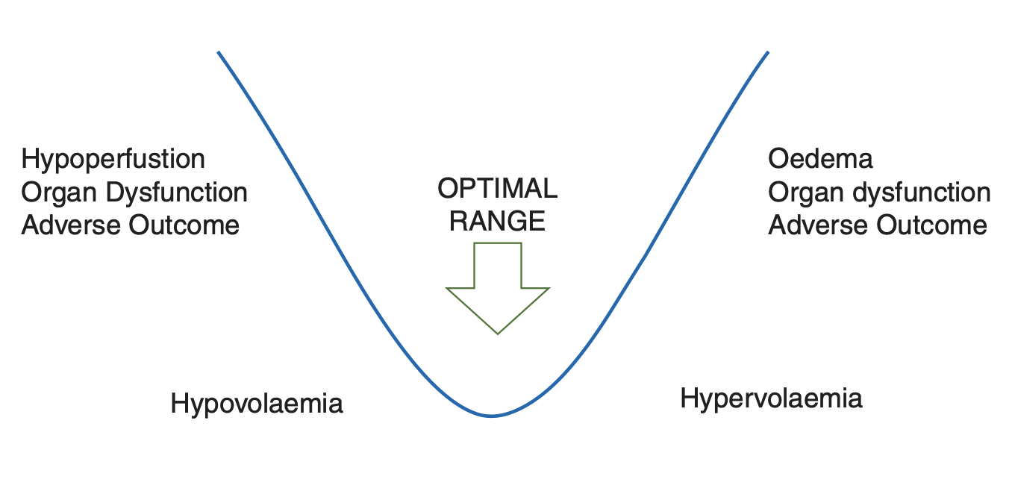
Judging fluid administration remains a challenge
“The goal of IV fluid administration is to restore and maintain tissue fluid and electrolyte homeostasis and central euvolemia, while avoiding salt and water excess. This will in turn facilitate tissue oxygen delivery without causing harm”
Miller & Myles 2009

Slide 3
Practical Goals
Adequately fill vascular system to achieve venous return, stroke volume/cardiac output and a stable target blood pressure
Maintain a stable vascular volume despite ongoing renal, blood and insensible losses
Establishing pre-load dependency & relative position on the Frank-Starling curve
Minimize fluid and salt loading & 3rd spacing in the interstitial tissue compartment

Slide 4
Purpose of the fluid challenge
To establish pre-load dependency & relative position on the Frank-Starling curve
The principle behind the fluid challenge technique is that by giving a small amount of fluid in a short period of time, the clinician can assess whether the patient has a preload reserve that can be used to increase the stroke volume with further fluids.
Cecconi M, Parsons AK, Rhodes A. What is a fluid challenge? Curr Opin Crit Care. 2011 Jun;17(3):290-5. doi: 10.1097/MCC.0b013e32834699cd. PMID: 21508838.
The fluid challenge (FC) approach, which consists of the intravenous administration of small aliquots of fluids, over a relatively short period of time, to test if a patient has a preload reserve (i.e., the relative position on the Frank-Starling curve), has been used to guide fluid administration in critically ill humans.
Teixeira-Neto FJ, Valverde A. Clinical Application of the Fluid Challenge Approach in Goal-Directed Fluid Therapy: What Can We Learn From Human Studies? Front Vet Sci. 2021 Aug 3;8:701377. doi: 10.3389/fvets.2021.701377. PMID: 34414228; PMCID: PMC8368984.

Slide 5

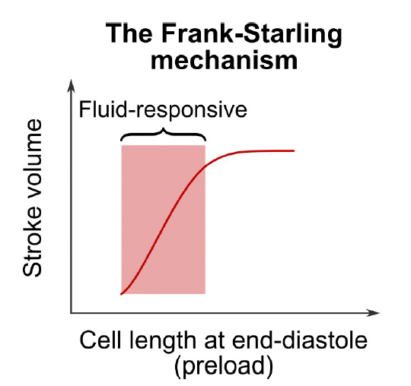
Physiology
The ability of the heart to change its force of contraction and therefore stroke volume in response to changes in venous return is called the Frank-Starling mechanism
Increased VR will increase the end diastolic volume filling of the ventricle i.e. increase preload – if preload dependent / fluid responsive the stroke volume will increase
Vs
Vu
Vs
Stressed volume MSFP
The gradient between the venous mean systemic filling pressure (MSFP) and right atrial pressure (RAP) drives venous return VR to the heart. FC intravenous fluid administration will increase VR and preload via increases in Vs and MSFP

Slide 6



The fluid challenge methodology
Identifying the main sources of variation in the impact on BV
Impact on FC interpretation
Type of fluid used
Blood Volume Estimation
Plasma vol.
HCT
Timing of ∆SV% assessment
Kg/MAP
[Hb]
Varying Fluid Losses
Vol. & Rate
Body position
Variation in the change in BV following a FC translates into potential errors into both the characterization of fluid response status and defining the patient’s position on the FS curve

Slide 7
What’s changed / available now ?
Better understanding of the physiology of iv fluid redistribution and elimination
Mathematical models of the pharmacokinetics of iv administered fluid
Availability of continuous fluid responsive and hemodynamic parameters
Computer processing for kinetic simulation, parameter integration and advanced display GUI

Slide 8
Simulating the impact of IV fluids on blood volume changes
IV Fluid Challenge(s) under anesthesia
Net result of impact pharmacokinetic of anesthesia is that as the Vc expands with each FC the net rate loss of fluid increases, this makes the BV change variable & hard to predict without computer simulation
K₁₂ rate is ∝ Vc expansion - net fluid is lost to tissues as return of fluid rate K₂₁ is suppressed
Vc
Blood volume
K₁₂
Vt
Tissue volume
K₂₁
K₂₁ & K₁₀ rates are reduced under anesthesia
K₁₀
Urine output

Slide 9
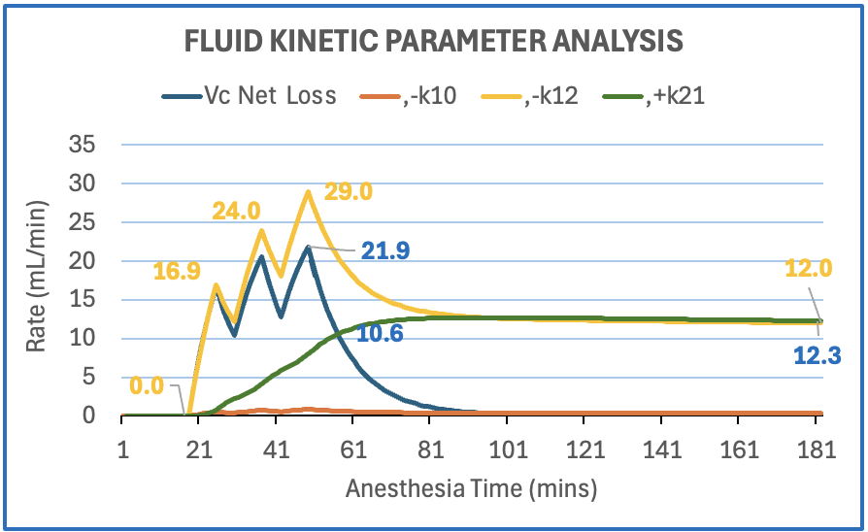
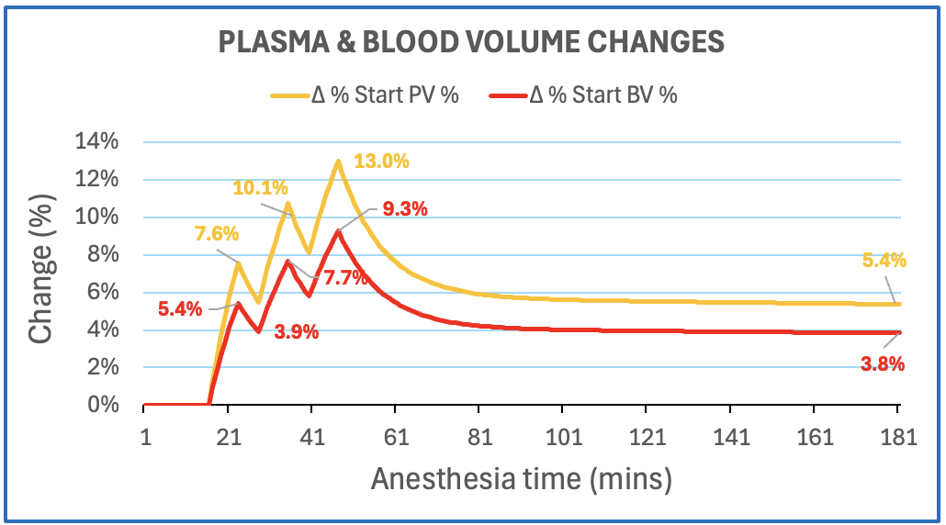
Lessons from pharmacokinetic analysis of the BV impact of crystalloid FCs
The BV impact of a fluid challenge is offset by the loss rate (K₁₂) of fluid to the tissue compartment. This rate increases as it is ∝ to the BV expansion
The % changes in BV achieved after a FC are therefore variable and the % change reduces across a series of FCs
The BV expansion falls quickly after the FC in an exponential manner reaching equilibrium in 30 minutes when the tissue fluid return rate (K₂₁) matches the Vc loss rate

Slide 10
Kinetic analysis challenges FC assumptions
The underlying assumption of the current fluid challenge (FC) procedure is that the fluid administered will cause a material and repeatable change in BV for one or more FCs
Pharmacokinetic modelling of IV fluid administration has revealed that the FC procedure will result in a variable and diminishing (across a series of fluid challenges) BV change – particularly if crystalloids are used
This impacts both the precision of the determination of fluid responsiveness and leads to uncertainty regarding the patient’s position on the Frank Starling curve

Slide 11

Summary
Existing FC procedure is not fully optimized to establish pre-load dependency & relative position on the Frank-Starling curve
Limitations of the conventional FC procedure
Does not factor in that the BV changes by a variable amount – is therefore likely to over diagnose non responsiveness
Solely characterizes the patient as responsive or not
Does not report position on the FS curve
Does not predict BV changes post FC and continue to guide re fluid dependency status
Non-responsive
?
?
?

Slide 12
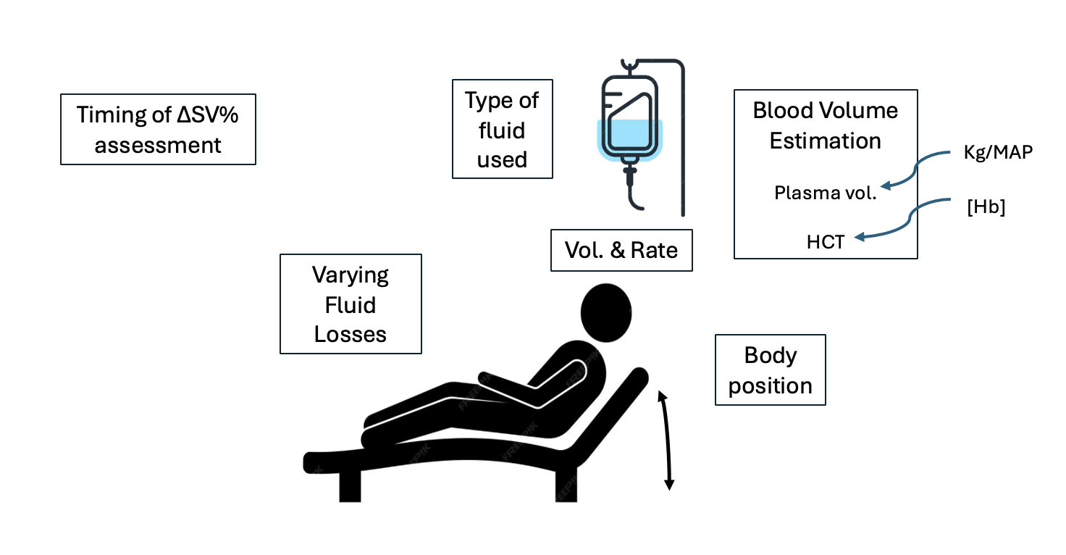
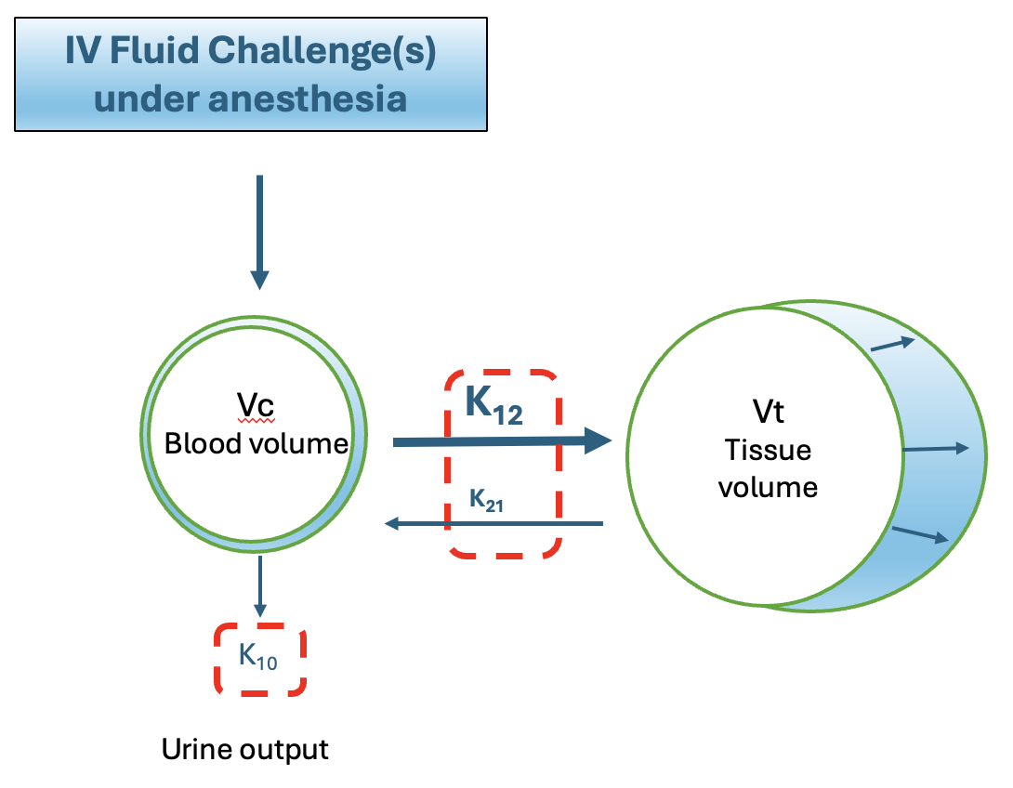
Combining fluid challenge simulation with hemodynamic monitoring
Potentially achieves both the FC goals of:
Defining pre-load dependency
Establishing relative position on the Frank-Starling curve
Pharmacokinetic simulation should allow for variations in the FC impact on stroke volume and better assess the physiological response

Slide 13
How could this this work?
OFIS® Optimizing Fluids in Surgery

Slide 14
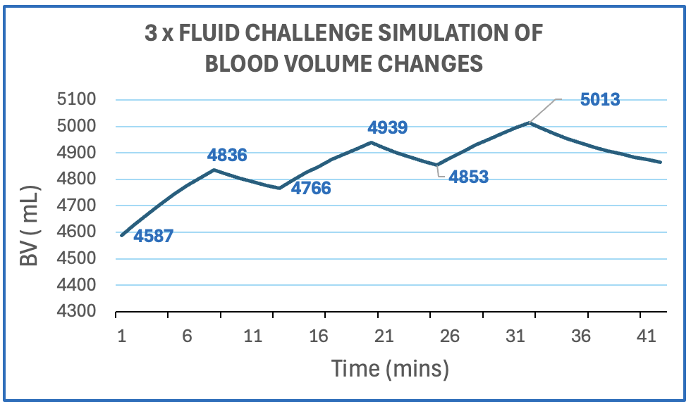
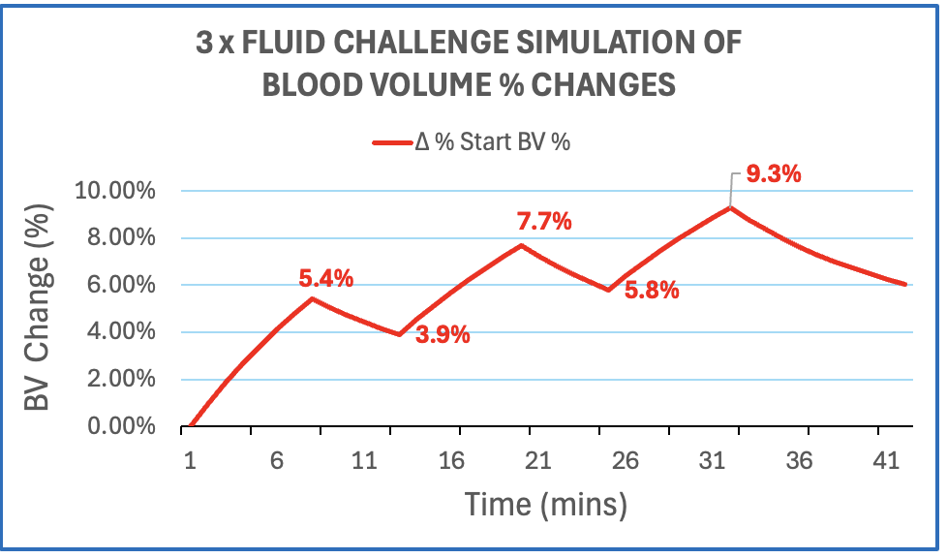
Establishing pre-load dependency
Step 1 Estimate trends in BV changes from the FC/FC series and measure stroke volume response

Slide 15
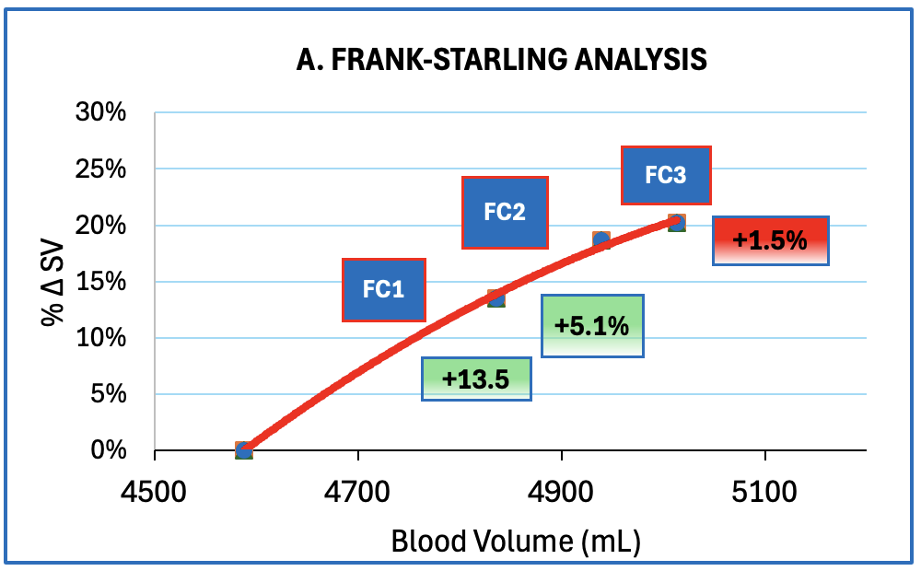
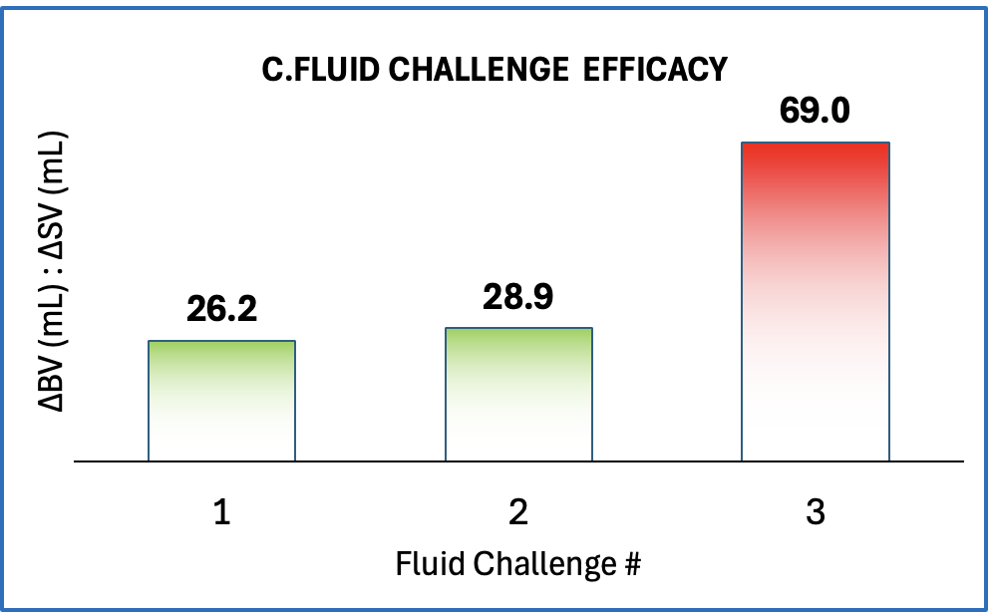
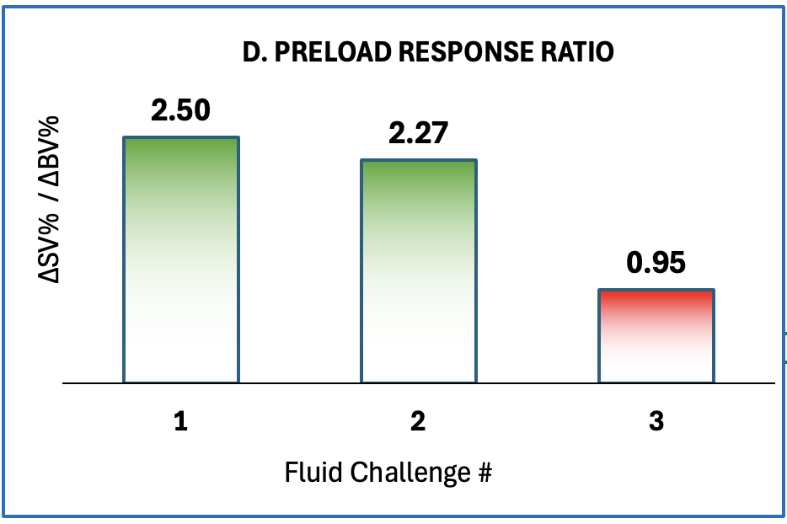
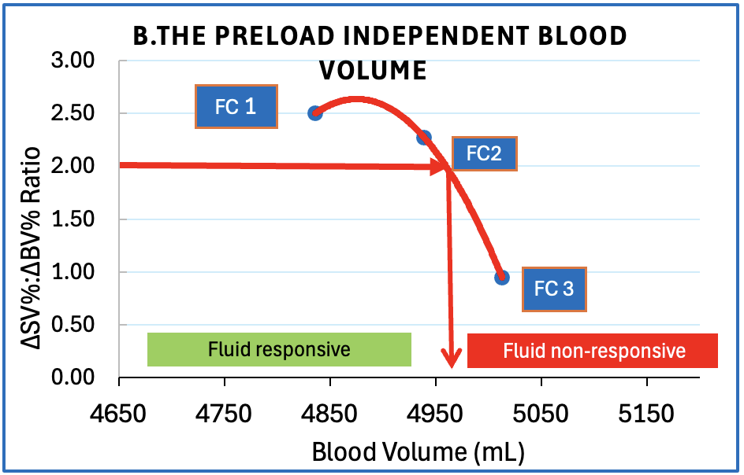
Establishing pre-load dependency
Plot %∆SV vs ∆BV & show %∆SV for each FC
Calculate FC efficacy in terms of ∆BV/∆SV
Graph Ratio of %∆SV / ∆BV
Green shade (ratio ≥ 2x ) for fluid responsive FC
Define fluid responsive & non-responsive BV zones for further fluid management

Slide 16
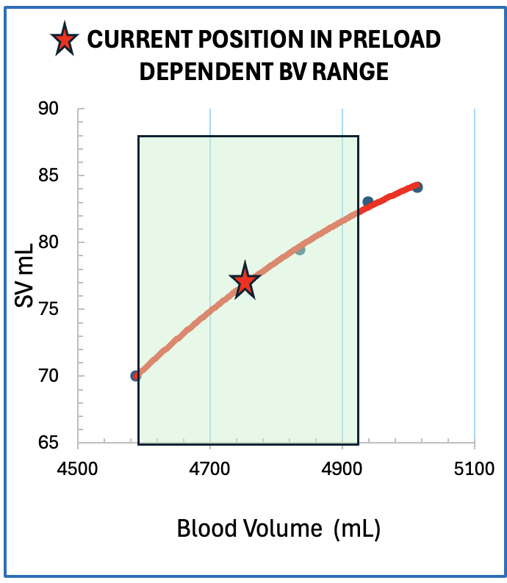
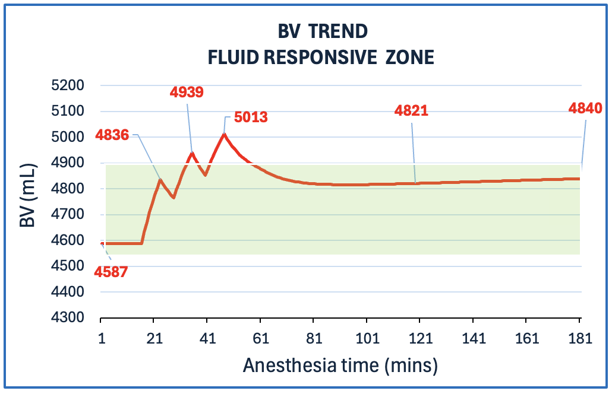
Establishing relative position on the Frank-Starling curve
Provide a projected BV trend analysis
@ 4ml/kg/hr maintenance fluid rate

